Slide 1
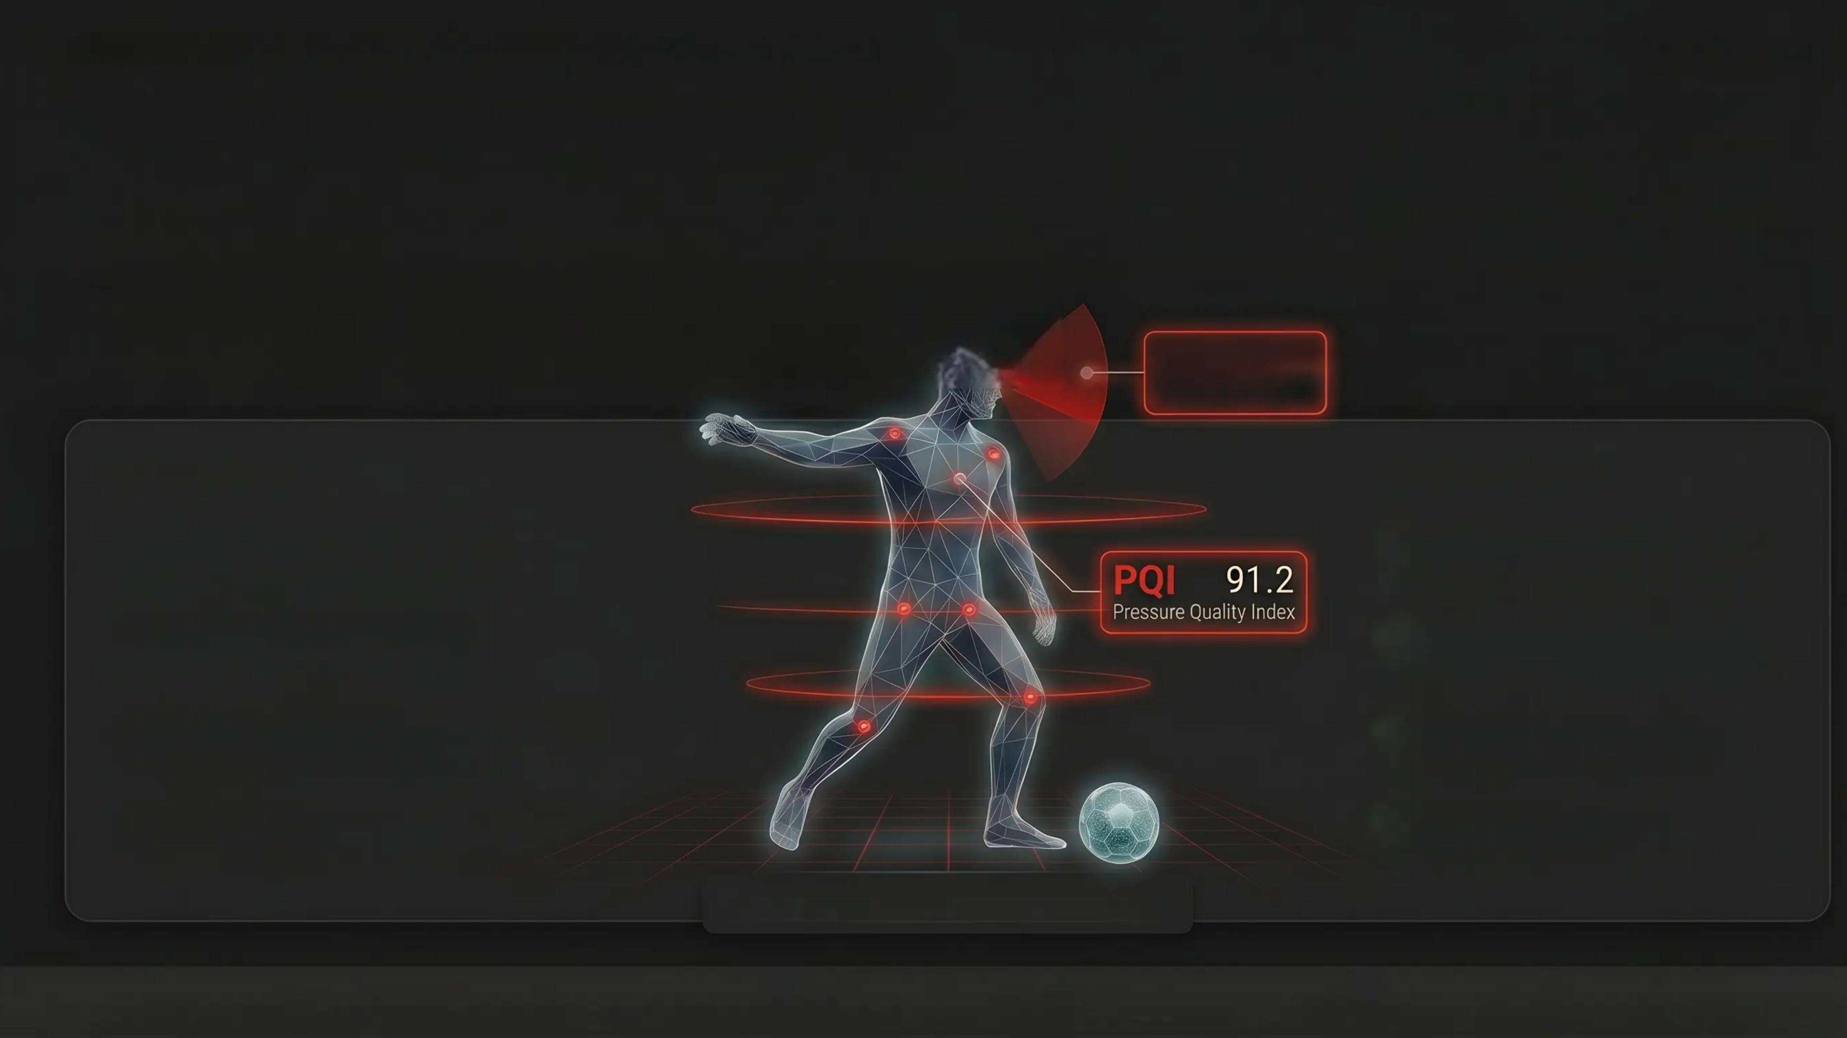
AWS World Sports Innovation Cup 2026 • Unlock 3D Football Data
Team: itzmore
141 Million Data Points Per Match.
Zero Body Intelligence Metrics. Until Now.
Measuring Cognitive Awareness & Pressing Mechanics from 3D Skeleton Data at Bundesliga Scale
AWI 87.3
Awareness Index
THE PROBLEM
THE SOLUTION
❌ Position tracking only – no body mechanics ❌ Invisible cognitive load & scanning patterns ❌ Pressing intensity unmeasured at joint level ❌ 141M data points/match go untapped
✔ AWI – Awareness index from head orientation ✔ PQI – Pressure Quality from joint biomechanics ✔ 5 Bundesliga matches analyzed at scale ✔ AWS SageMaker + Bedrock pipeline
From position to body intelligence
5 Bundesliga matches • 141M data points/match • 400 player-phase rows • 177 unit tests • Production-containerised pipeline (Docker → ECR → SageMaker)

Slide 2
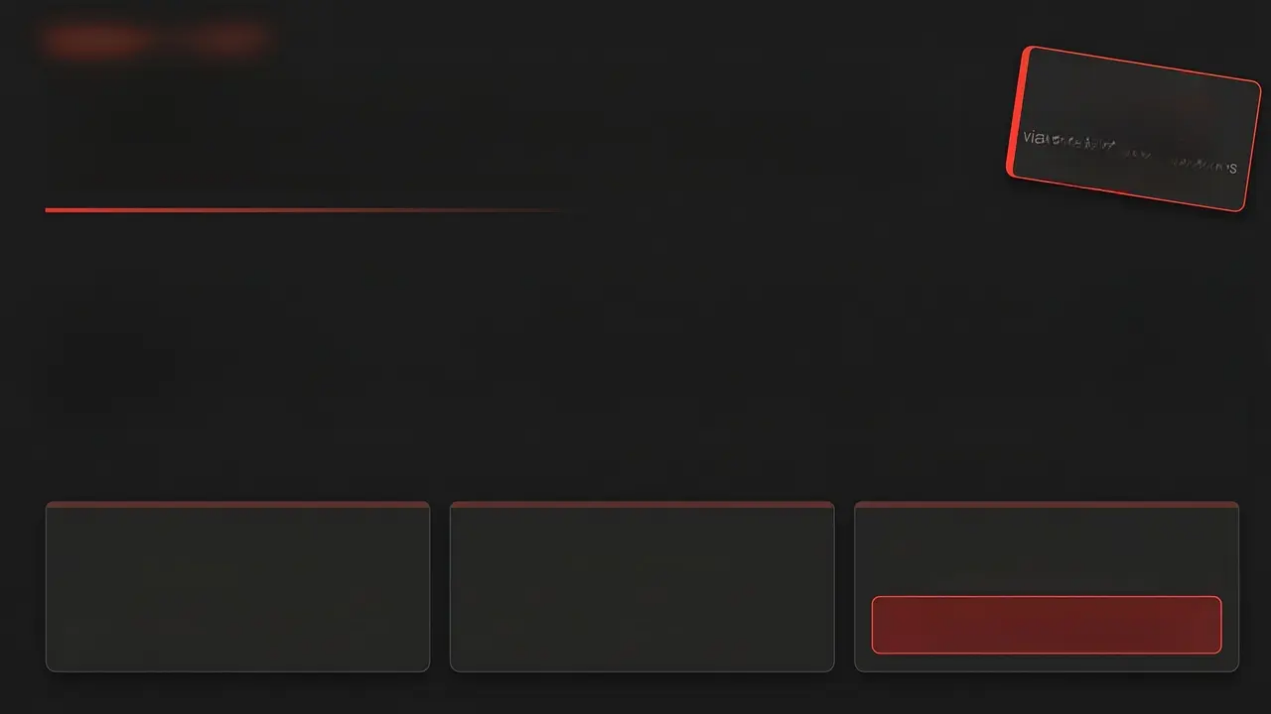
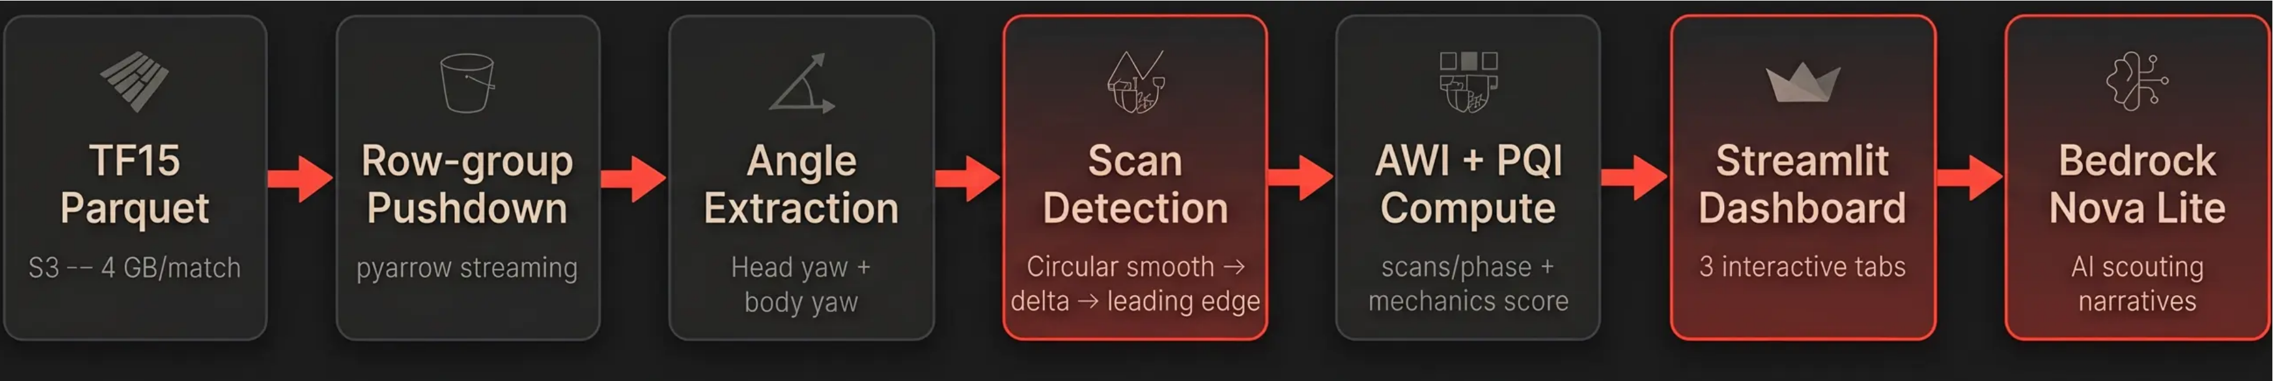
TECHNICAL PIPELINE
S3 to Scouting Narrative in 15 Minutes. At Bundesliga Scale.
~15 min
5 matches x 2 metrics via SageMaker 10 parallel jobs (vs. ~2 hrs local)
Circular Smoothing
Leading-Edge Counting
Press Filter
sin/cos Decomposition
1 Rotation = 1 Event
≥10 Consecutive Frames
Standard rolling mean breaks at +190°. Circular smoothing prevents angle-wrap errors in head rotation data.
A sustained head turn registers as a single scan event — not inflated frame-by-frame counts.
Excludes incidental proximity. Only genuine, intentional pressing phases are scored.

Slide 3
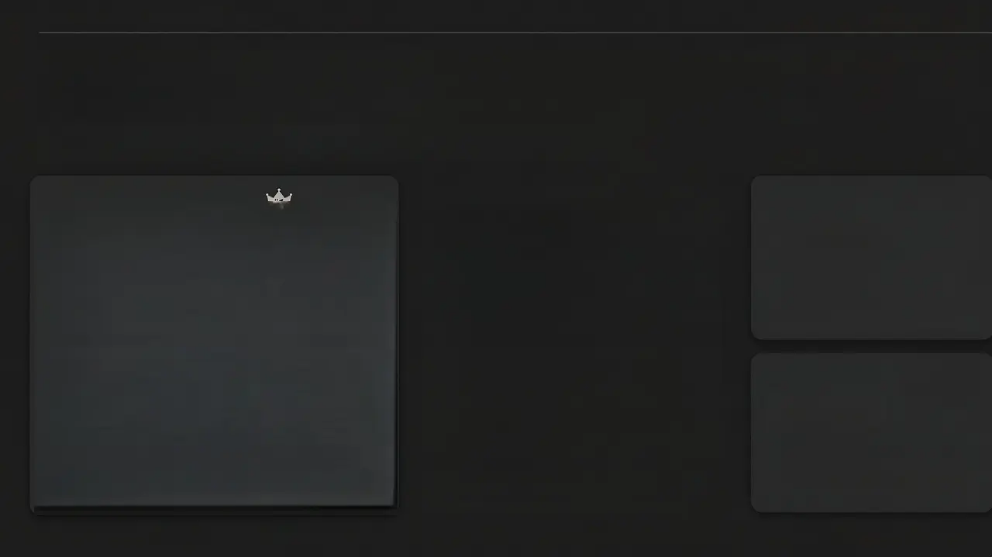
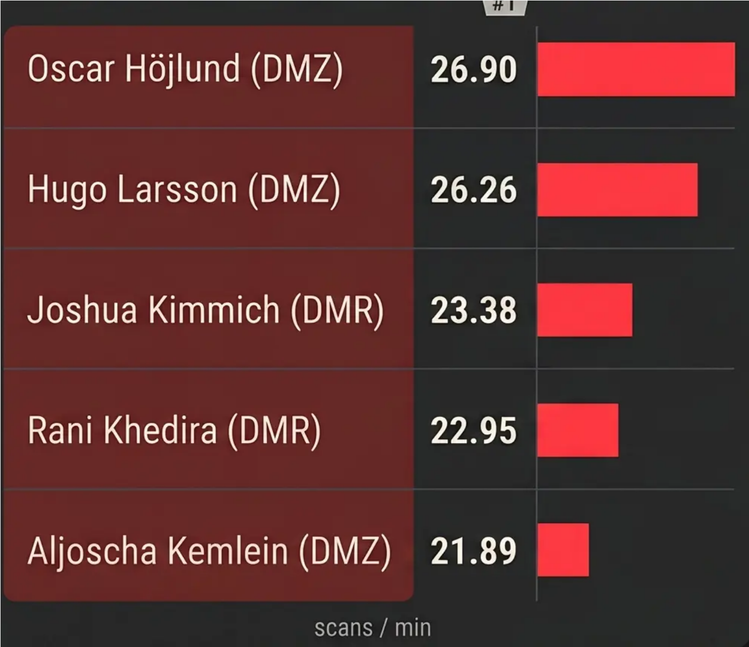
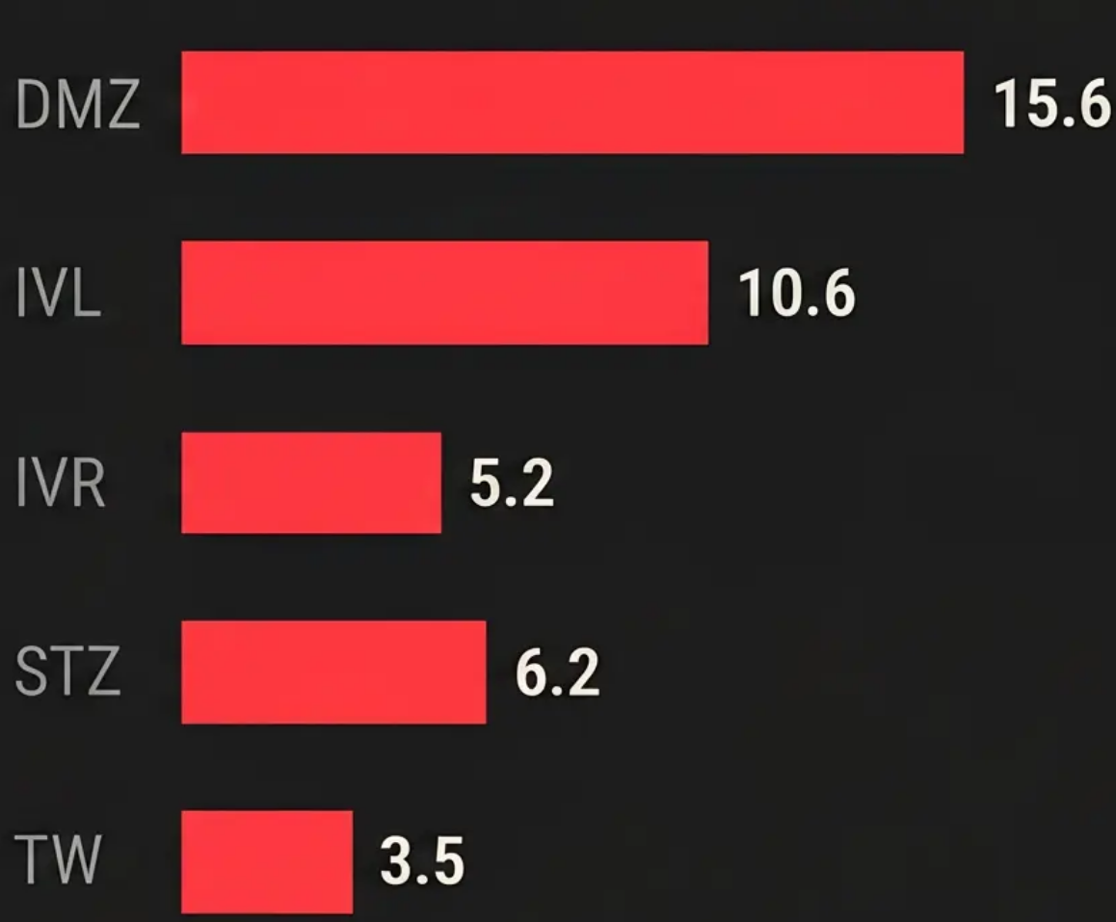
AWI RESULTS & KEY SIGNALS
Defensive Midfielders Are the Most Cognitively Active Players on the Pitch
AWI Spikes +57% Before Every Pass
TOP 5 · AWI LEADERBOARD
POSITION AVERAGE AWI
STABILITY
R = 0.854
p < 0.001 · n = 69 phases
AWI is a stable player trait – not a match-context artifact.
Kimmich: 21.77 > 21.16 over 47 min (variance: 0.6 seconds)
PRE-PASS SPIKE
+57%
5 seconds before ball release · 50 tps resolution
AWI captures the pre-decision cognitive window – playing with your head up', measured frame by frame.
Position mirrors cognitive demand
DMZ = Def. Mid Centre · STZ = Striker · TW = Goalkeeper
AWI derived from 3D nose - neck - ear keypoints · TRACAB TF15 · 50 frames per second · 5 Bundesliga matches

Slide 4
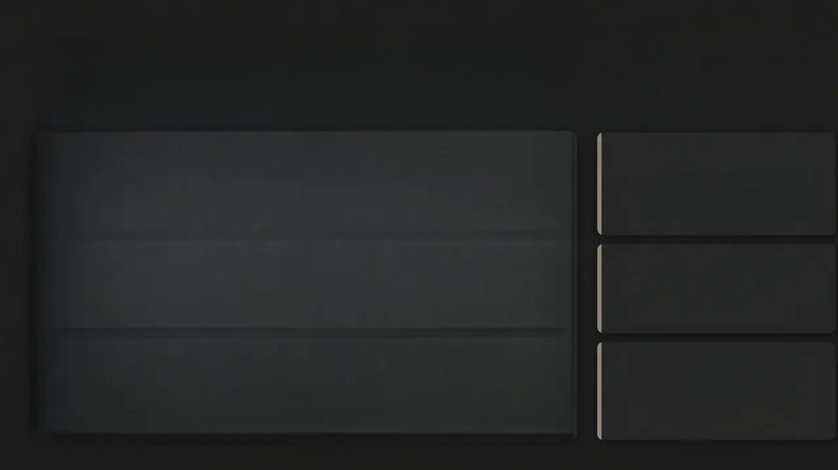
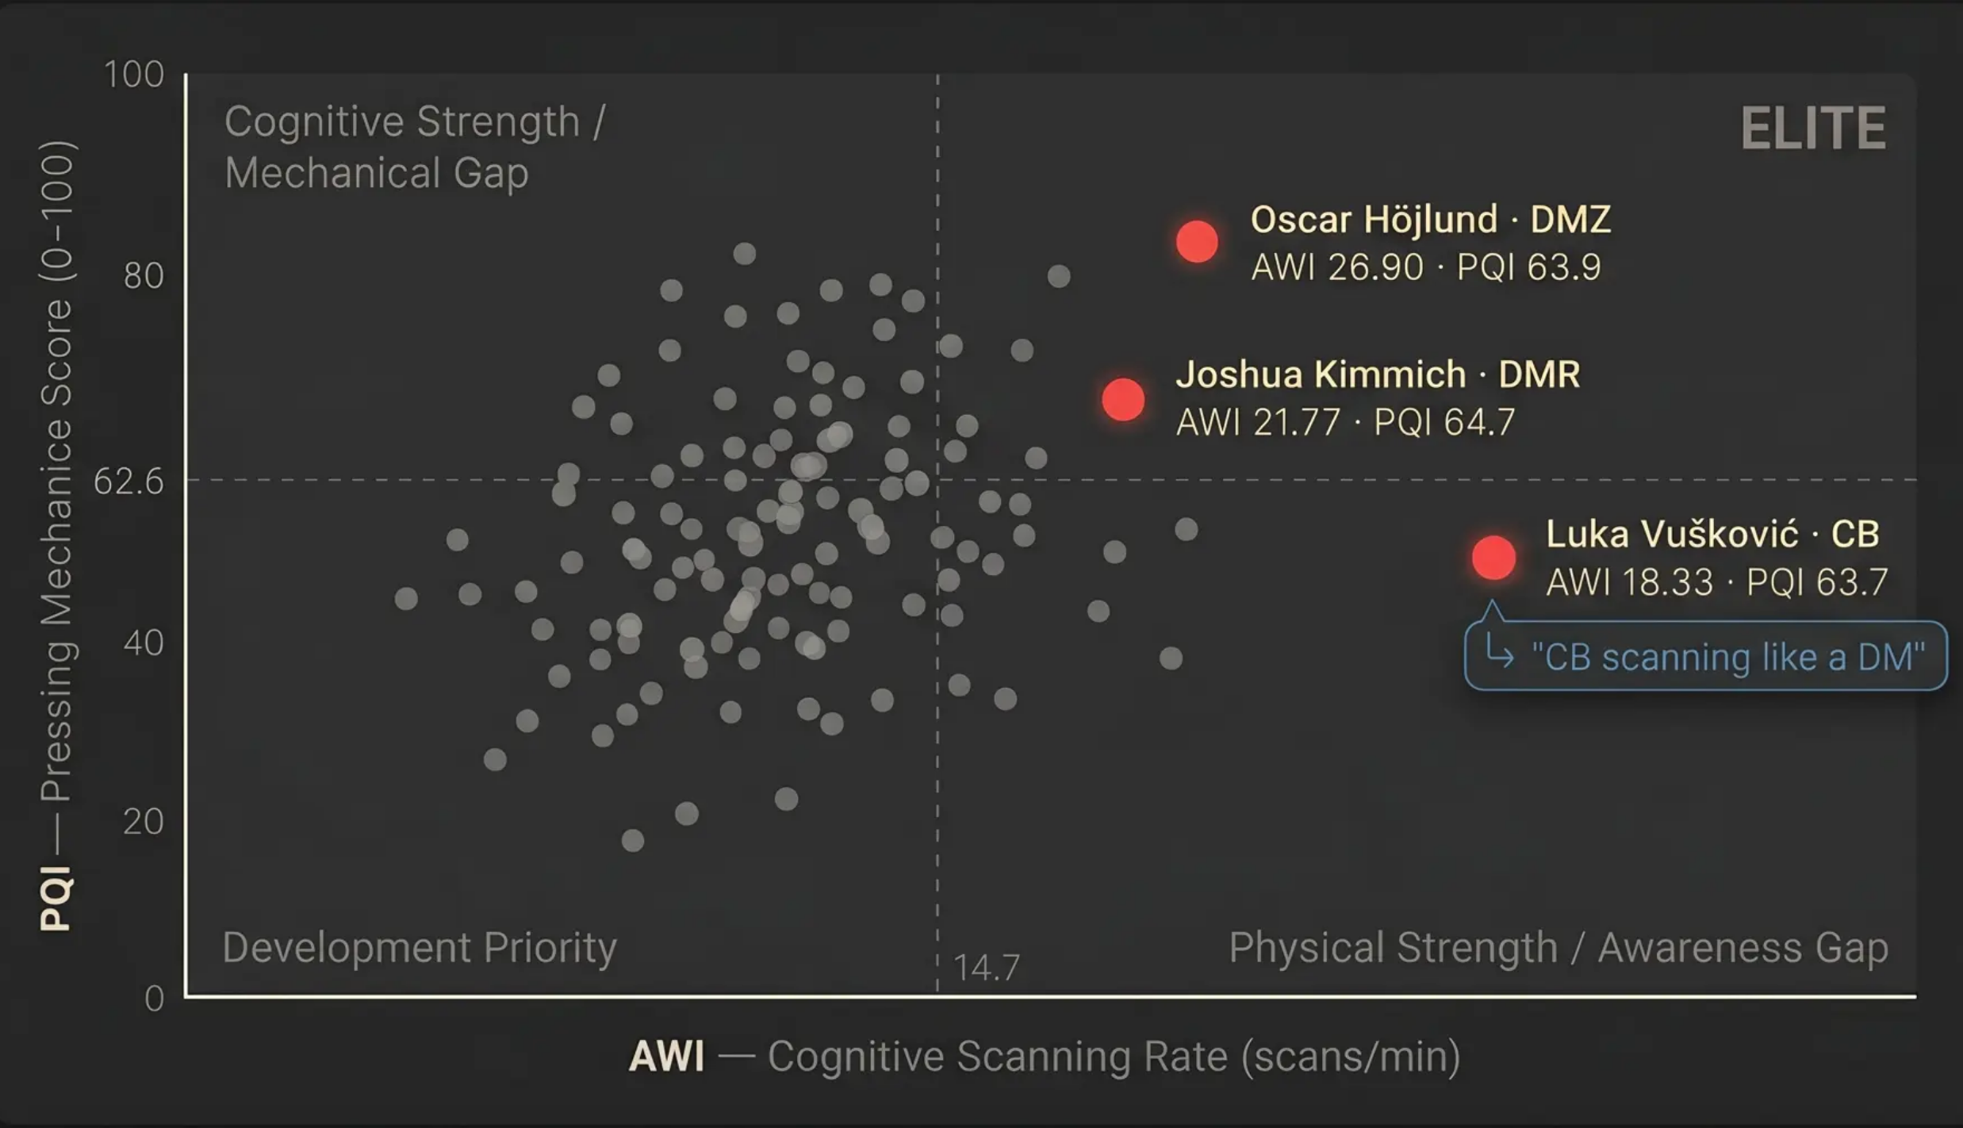



THE KEY FINDING — AWI × PQI INDEPENDENCE
Scanning Awareness and Pressing Mechanics Are Independent Skills. Both Are Required.
r = -0.11
p = 0.12 · n = 198 · Statistically independent. One metric alone misses half the picture.
Elite Quadrant
Only 10 unique players of 400 observations qualify.
Dual-threat rarity — exceptional in both dimensions.
Kimmich Fatigue Signal
AWI drops 52% in the second half 23.38 → 11:29 scans/min
Invisible to GPS. Visible here.
Vušković Versatility Flag
A-back scanning at DMZ rates. Positional versatility — surfaced automatically, no subjective bias required.
AWI derived from 3D nose - neck - ear keypoints · TRACAB TF15 · 50 frames per second · 5 Bundesliga matches

Slide 5
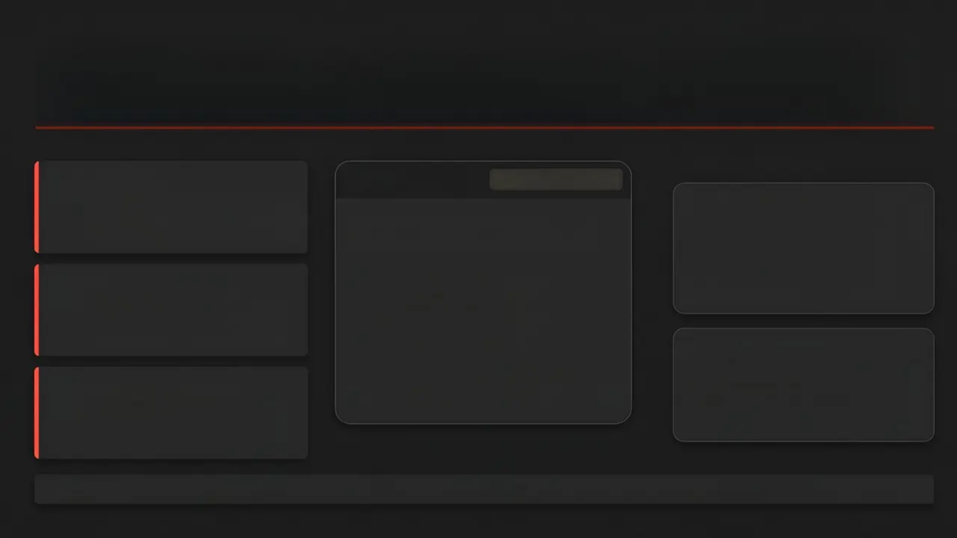



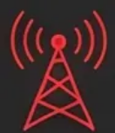
VALUE • LEARNING • WHAT'S NEXT
Bridging the Gap: Transforming 50 fps Skeleton Data into Actionable Coaching Intelligence
LESSONS LEARNED
Scouting
Amazon Bedrock Nova Lite
“Rank candidates on AWI and PQI independently. Find dual-threat players or target specific development gaps.”
Angle Calibration Challenge
Oscar Winther Höjlund • DMZ #1 of 400 • 72% above league mean
XY-plane projection compresses 3D head angles. Standard 30° threshold over-counted. Re-tuned to 45° — anchored on Kimmich's hand-coded video benchmark.
Fatigue Monitoring
PQI 63.9: proximity elite • 96.0 orientation • 59.0 stance • 38.1
AWI half-time comparisons surface cognitive disangagement before it becomes a tactical problem.
Press Filter Iteration
→ Deploy in high-press systems where pre-scanning enables ball recovery.
3-frame minimum yielded noisy scores. Raised to 10 consecutive frames (0.2 s) — fewer raw observations, dramatically higher signal fidelity.
Broadcast Overlay
Sub-155 latency, already validated. “Höjlund scanned 27 times before that interception.”
AI-generated scouting narrative from raw skeleton data
Pre-pass AWI → progressive pass rate correlation → Full-season development arcs & fatigue tracking → Live DFL matchday stream integration • <1 s Latency

